Slide 1
CO2 Emmisions
Team 14

Slide 2
Planning

Slide 3

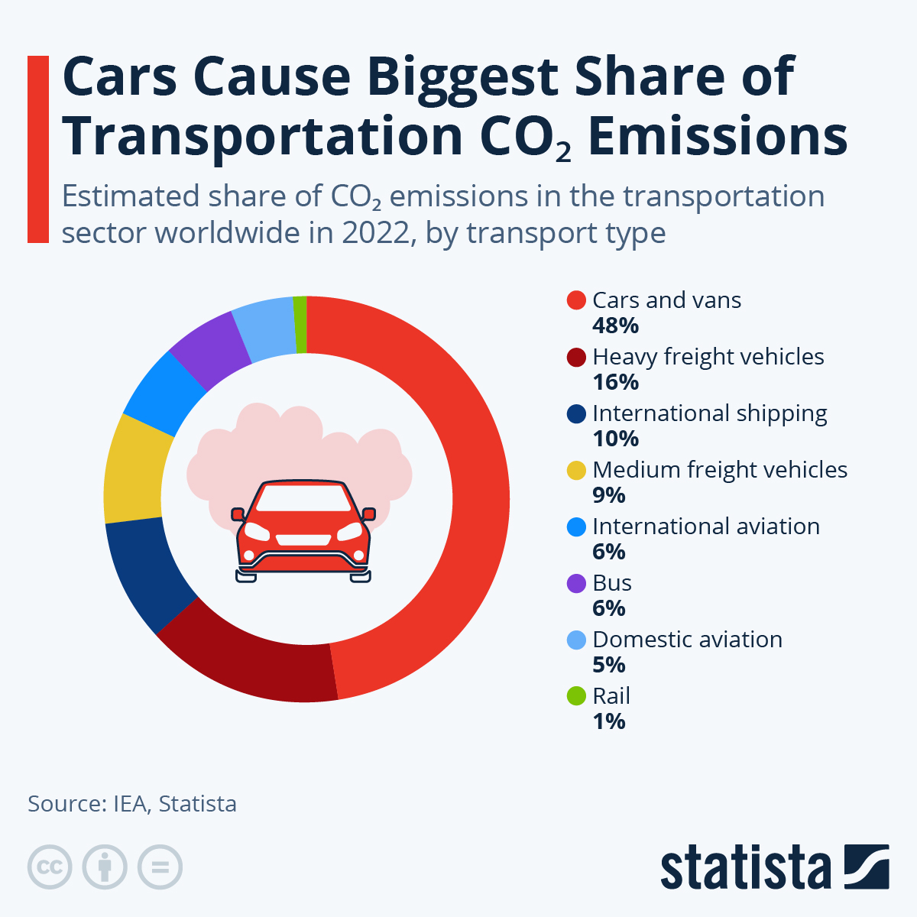
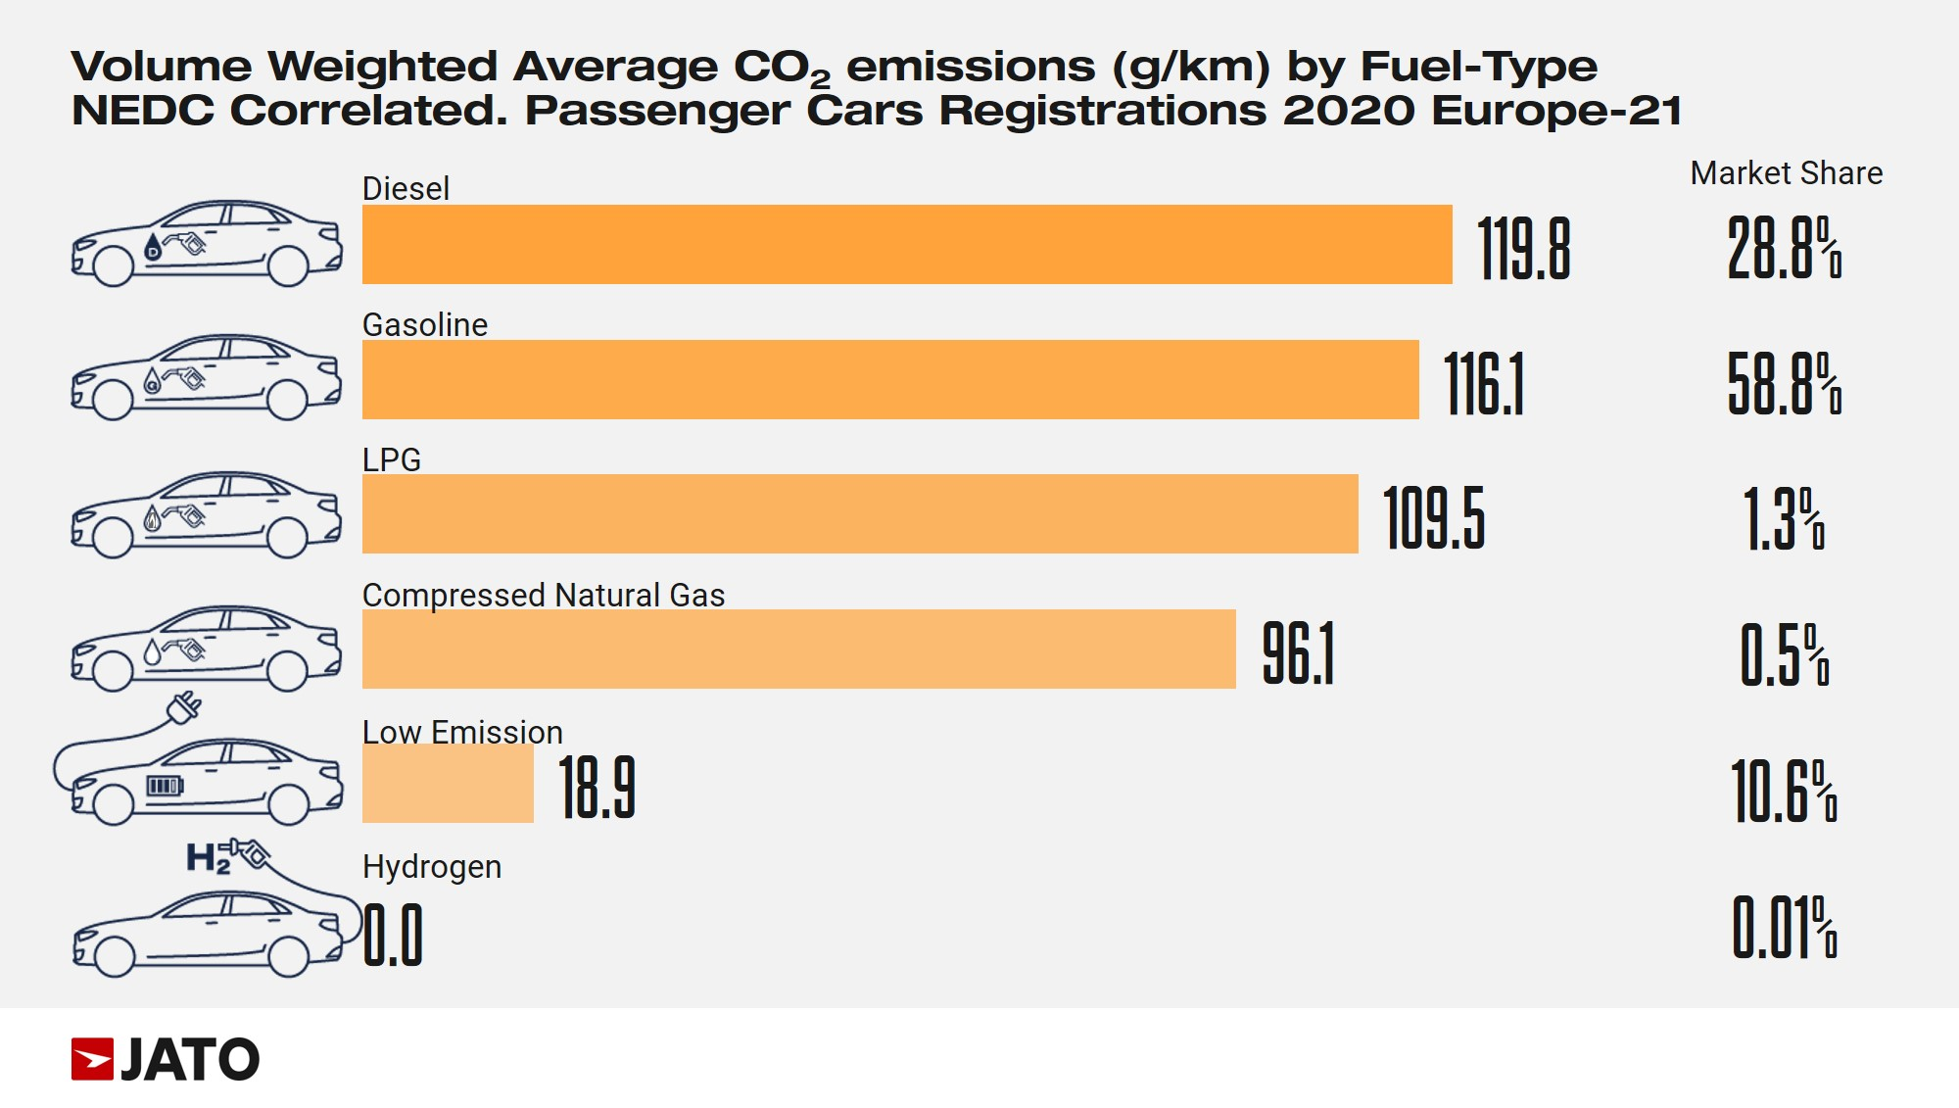
Problem to solve
Sustainability in Mexico:
Lack of education towards the effects of cars to the environment.
A large percentage of transportation contamination.

Slide 4
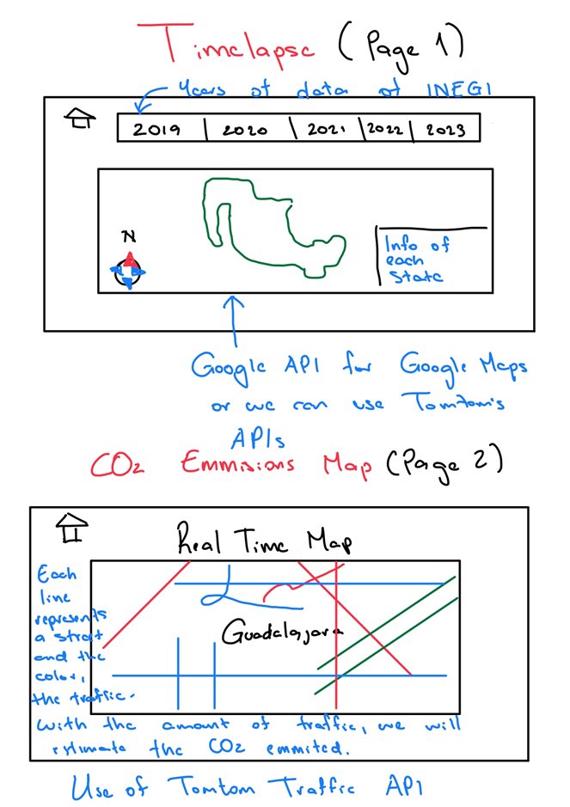
Solution
Timelapse:
Per year data
Interactable
Easy to use
CO2 Real Time Emissions Map:
Real time information
API connection

Slide 5
Execution

Slide 6
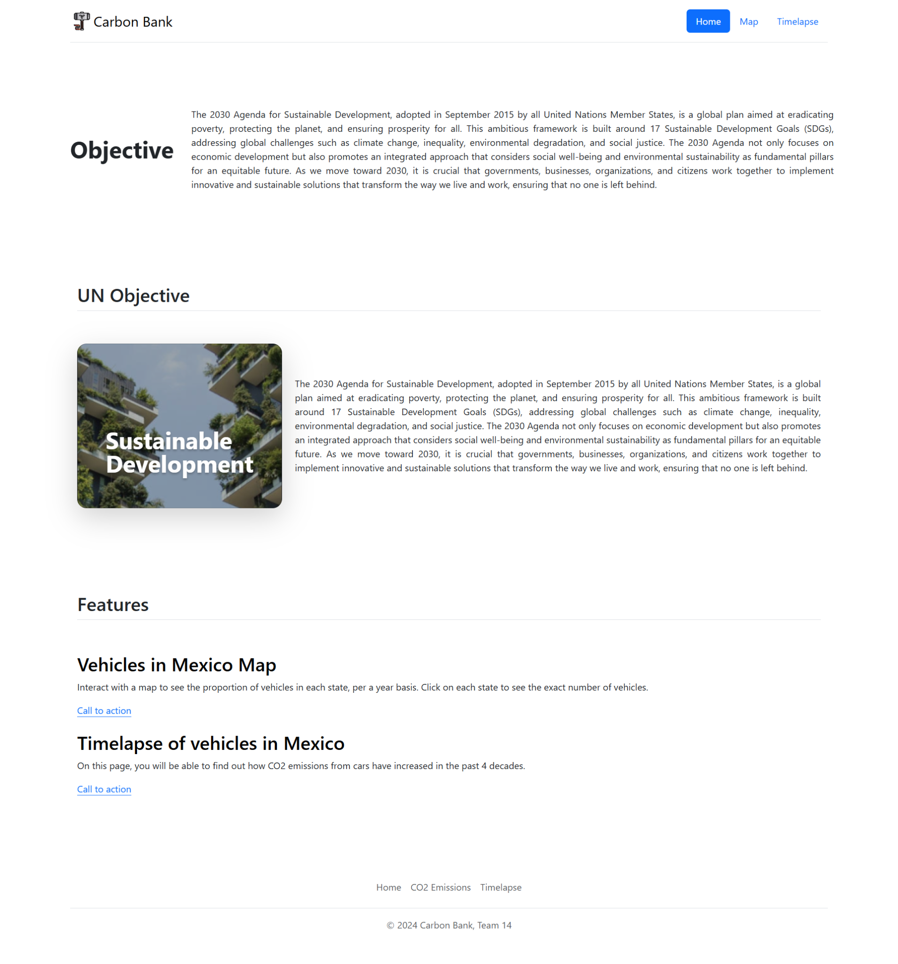
Evolution
Challenges:
No features working
Set up of Github page
Styling with Bootstrap

Slide 7
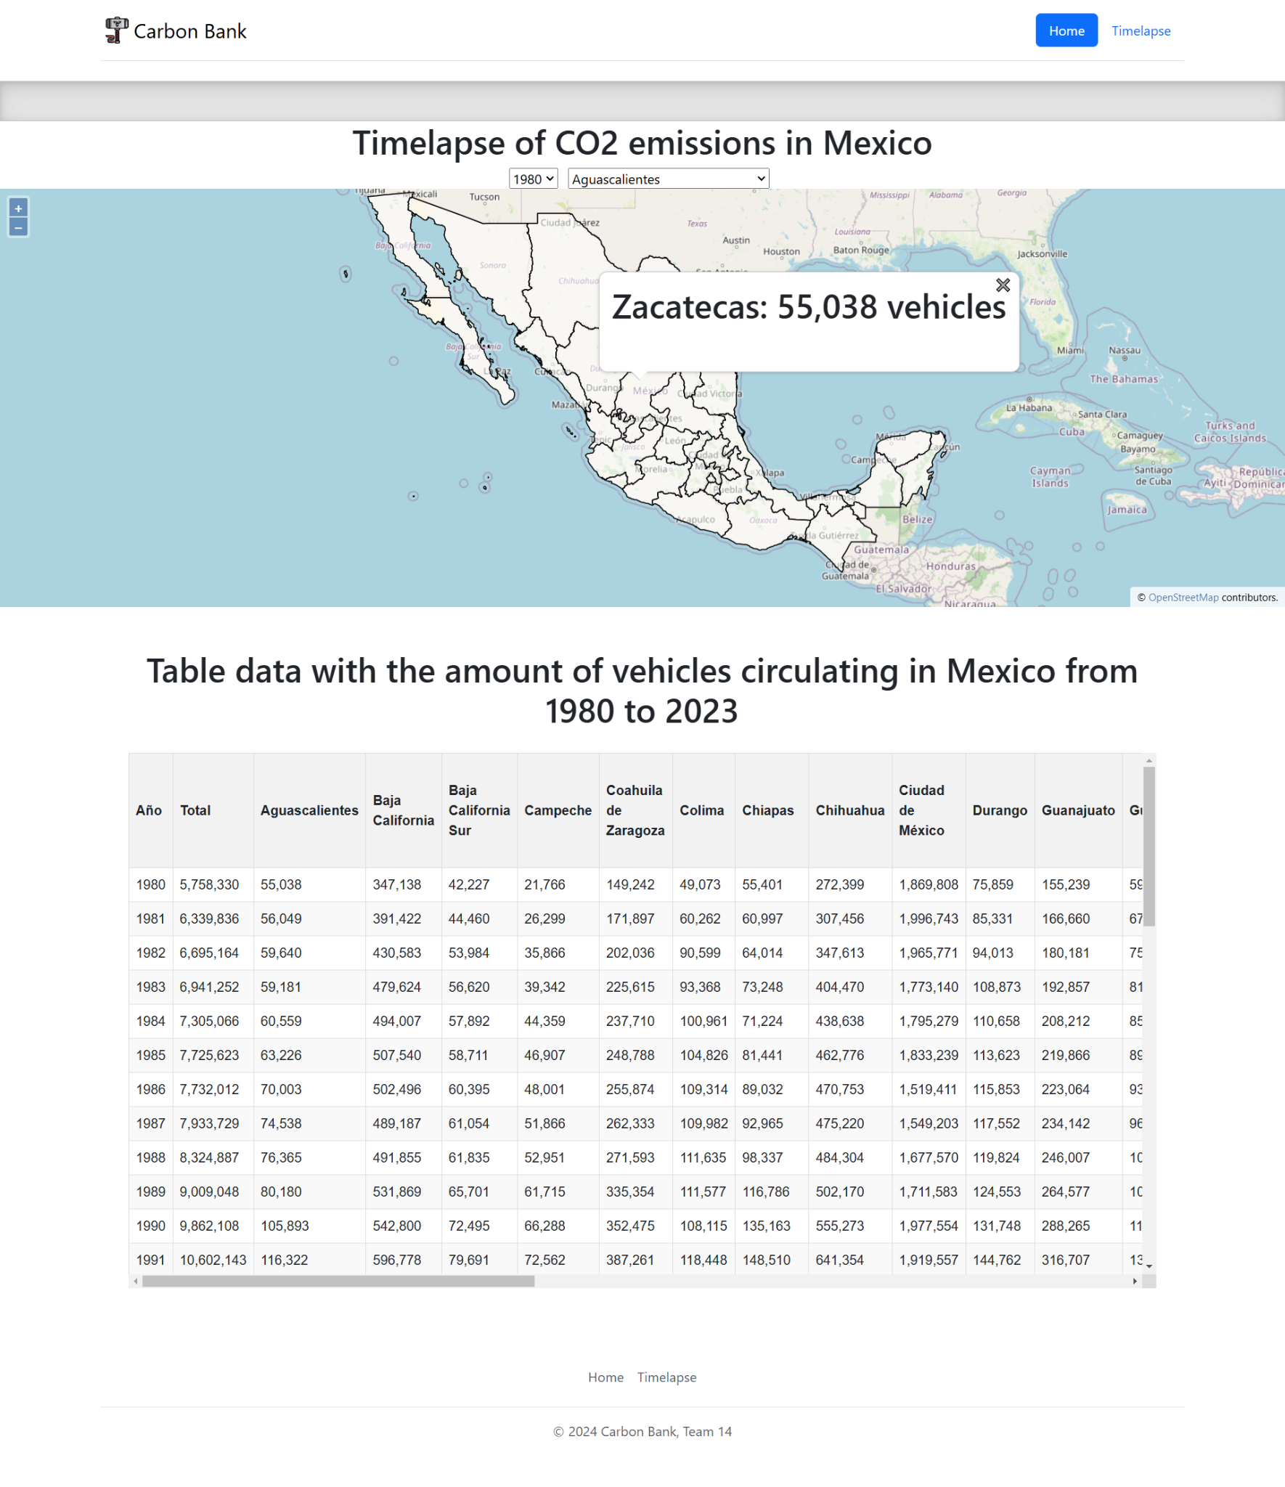
Evolution
Challenges:
Discarding of Tomtom API
Finding a proper API
Connectivity with backend and API

Slide 8
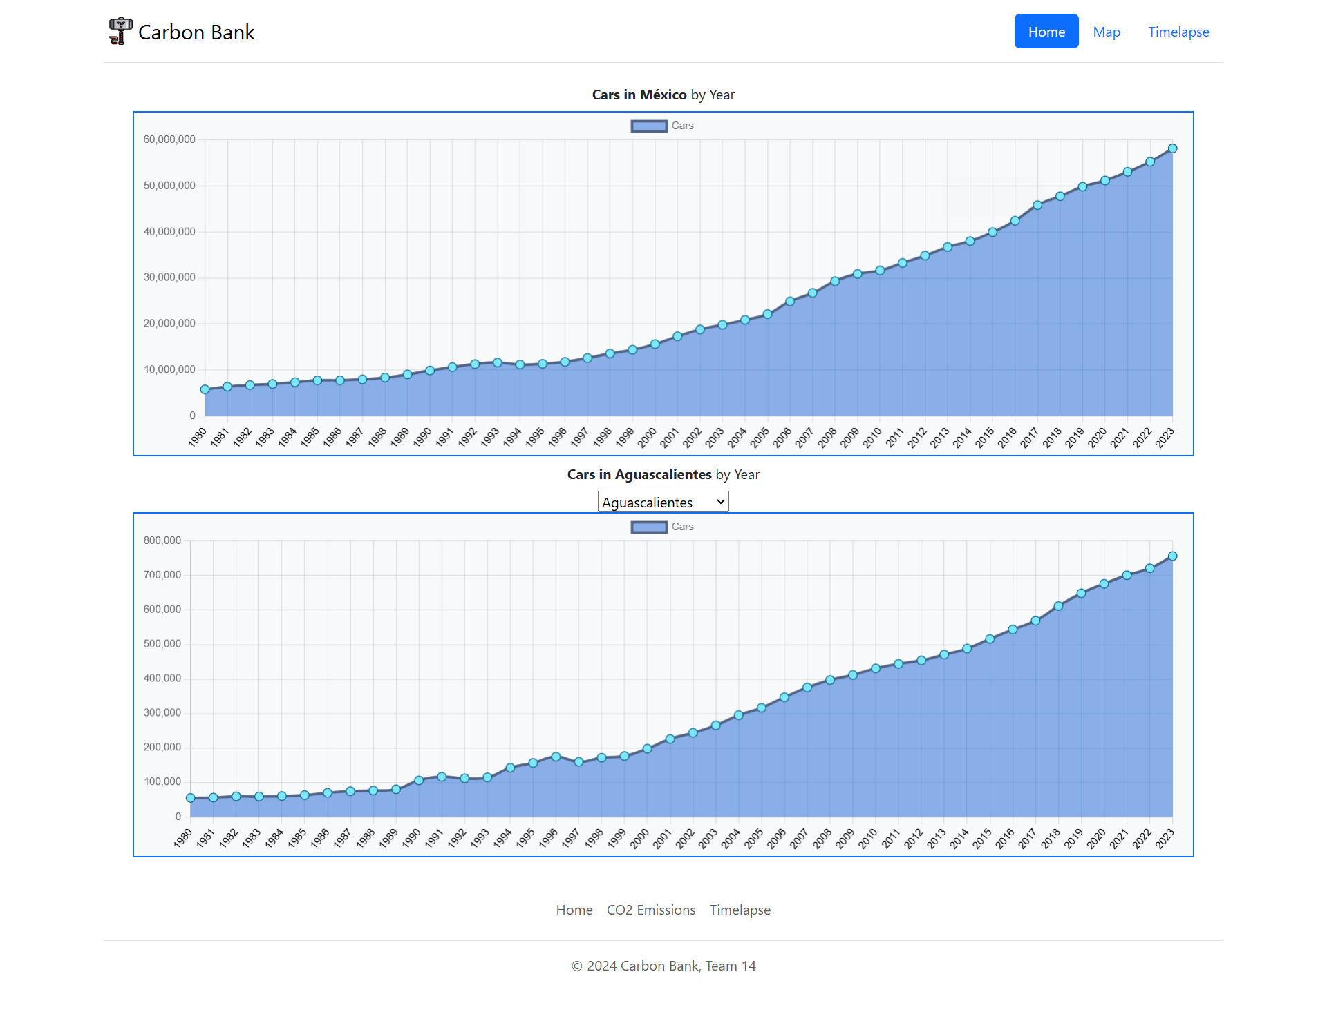
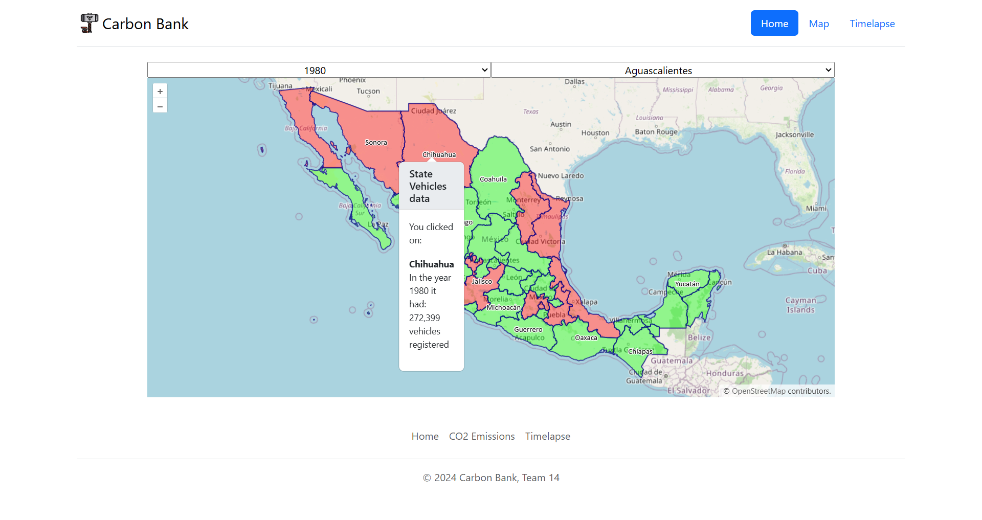
Evolution
Challenges:
Migration to React
Proper use of Openlayers API and Chart.js
Fixing the UX

Slide 9
Showcase

Slide 10


Carbon Bank

